Slide 1
Introduction to Mark Logic

Slide 2
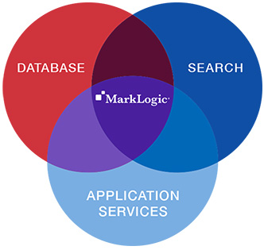
What is Mark Logic?
Including XML and JSON documents, transactional data, social media, metadata, geospatial data, binaries, RDF triples, and more.
Transactions, Analytics, and Search
High security

Slide 3
Pre-requisites for Mark Logic
XML Fundamentals
Xpath Fundamentals
XQuery

Slide 4
XML
<?xml version="1.0" encoding="UTF-8"?>
<library>
<author name="Boynton">
<book>
<title>Barnyard Dance!</title>
<year>1993</year>
</book>
<book>
<title>Hippos Go Berserk!</title>
<year>1996</year>
</book>
</author>
<author name="Seuss">
<book>
<title>Fox</title>
<year>1965</year>
</book>
</author>
</library>

Slide 5
XPath
XPath is a language for finding information in an XML document.
XPath is used to navigate through elements and attributes in an XML document.
XQuery uses path expressions to navigate through elements in an XML document
Steps are separated by “/” or “//”
Steps can be relative or absolute
Relative – no leading slash, starts at current item
Absolute – leading slash, starts at the document root
Steps are evaluated left to right
eg: /bookstore/book/title

Slide 6
XPath
/library – Returns all library elements
/library/author[@name=“Boynton”] - Returns author elements with name attribute value as “Boynton”
//title - Returns all title elements.
//title[.="Fox"] – Returns all title elements having the value Fox
/library/author/book[title="Fox"]/title - Returns all title elements having the value Fox
/library/author/@name – Returns all author names
/library/author[1] – Returns the first author details
/library[1 to 2] – Returns the first 2 library details

Slide 7
XQuery
XQuery is the language for querying XML data
XQuery for XML is like SQL for databases
XQuery is built on XPath expressions
XQuery –
Path expressions
Element constructors
FLWOR (“flower”) expressions
FOR-LET-WHERE-ORDERBY-RETURN
LET $a:=avg(document("bib.xml")/bib/book/price)
FOR $b in document("bib.xml")/bib/book
WHERE $b/price > $a
RETURN $b

Slide 8
XQuery
for $x in doc("books.xml")/bookstore/book where $x/price>30 order by $x/title return $x/title
Conditional Expression
FOR $h IN //holding
ORDERBY $h/title
RETURN <holding>
$h/title,
IF $h/@type = "Journal"
THEN $h/editor
ELSE $h/author
</holding>

Slide 9
Existential Quantifiers
XQuery's SOME operator, the "existential quantifier".
Testing whether a condition applies for some node within a given node-set is natural in XPath
Tell me if there exists at least one reserve_price that is greater than 1000 dollars.
Return value if true if at least one reserve_price has value greater than 1000.
some $price in document("data/items.xml")//reserve_price
satisfies $price > 1000

Slide 10
Comparisons: Value Operators
Value operators
eq, ne, gt, ge, lt, le
Work on singleton values
Values must be comparable
Return Boolean values
Examples:
1 ne 2
1 lt 2
5 le 5
"a" lt "z"
“a" gt "A"
<a>MarkLogic</a> eq “MarkLogic”

Slide 11
SQL to XQuery Mapping
SQL statement | XQuery expression
SELECT * FROM users | /user
SELECT * FROM users WHERE age=33 | /user[age = 33]
SELECT fname,lname FROM users WHERE age=33 | /user[age = 33]/(fname|lname)
SELECT * FROM users WHERE age=33 ORDER BY name | for $user in /user[age = 33] order by $user/name return $user
SELECT * FROM users WHERE age>33 | /user[age > 33]
SELECT * FROM users WHERE age!=33 | /user[age != 33]

Slide 12
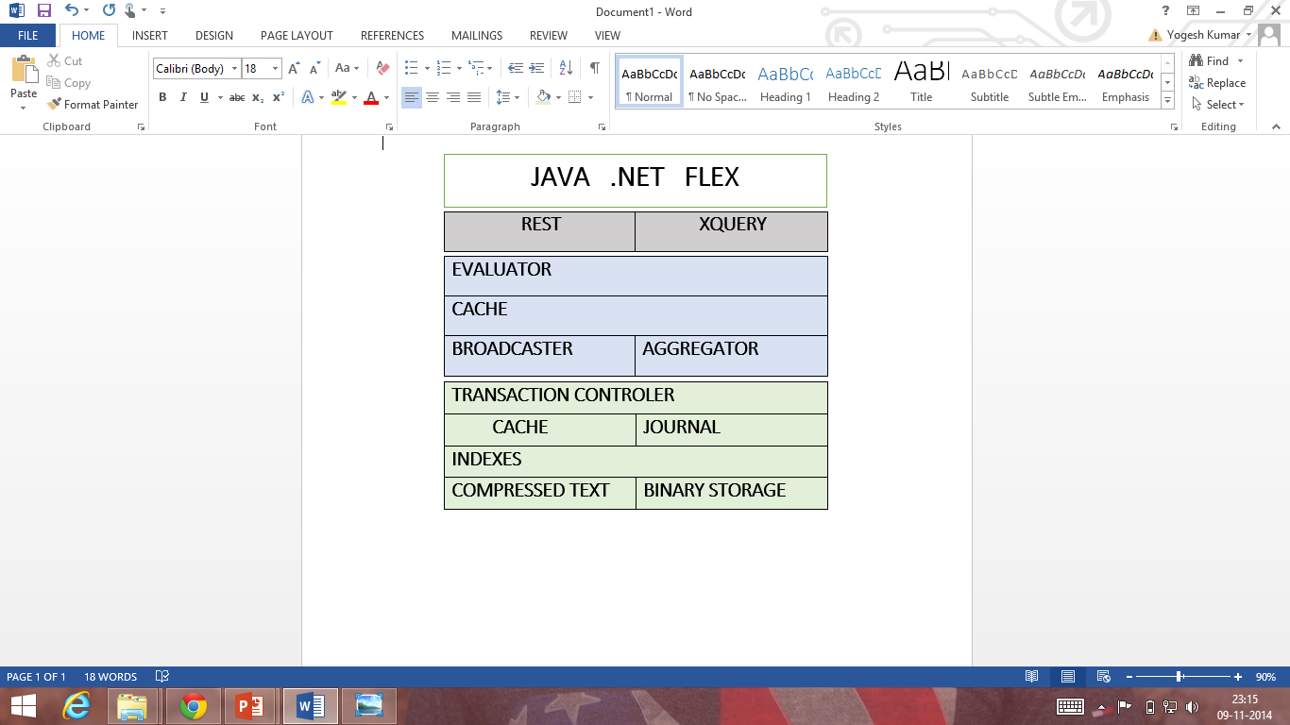
Mark Logic Architecture
Interface
Query Layer
Data Layer

Slide 13
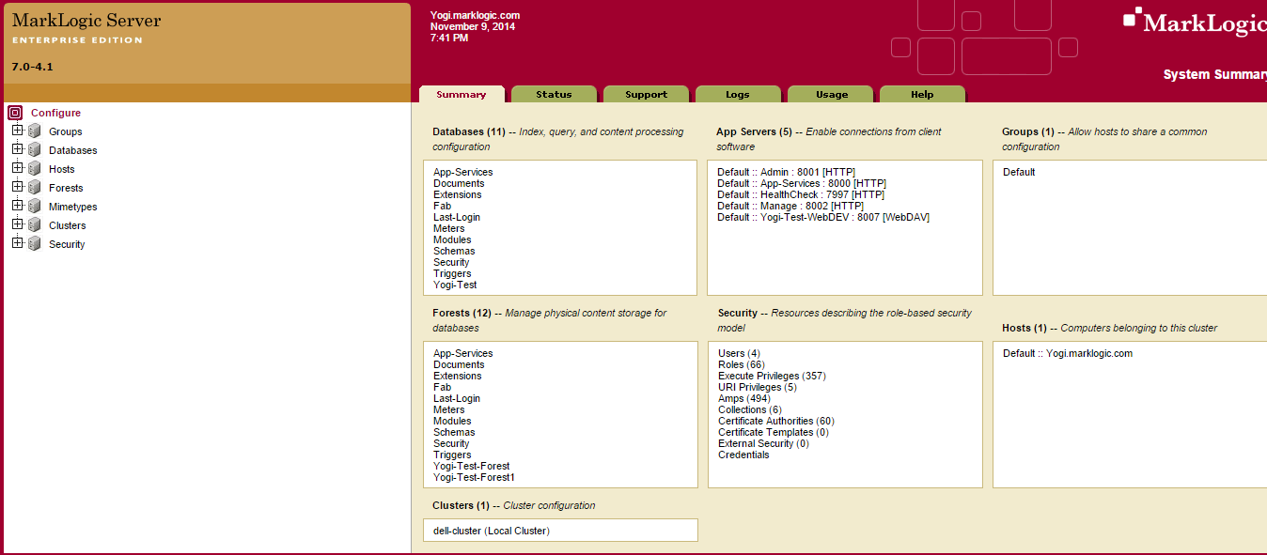
Mark Logic Home Page

Slide 14
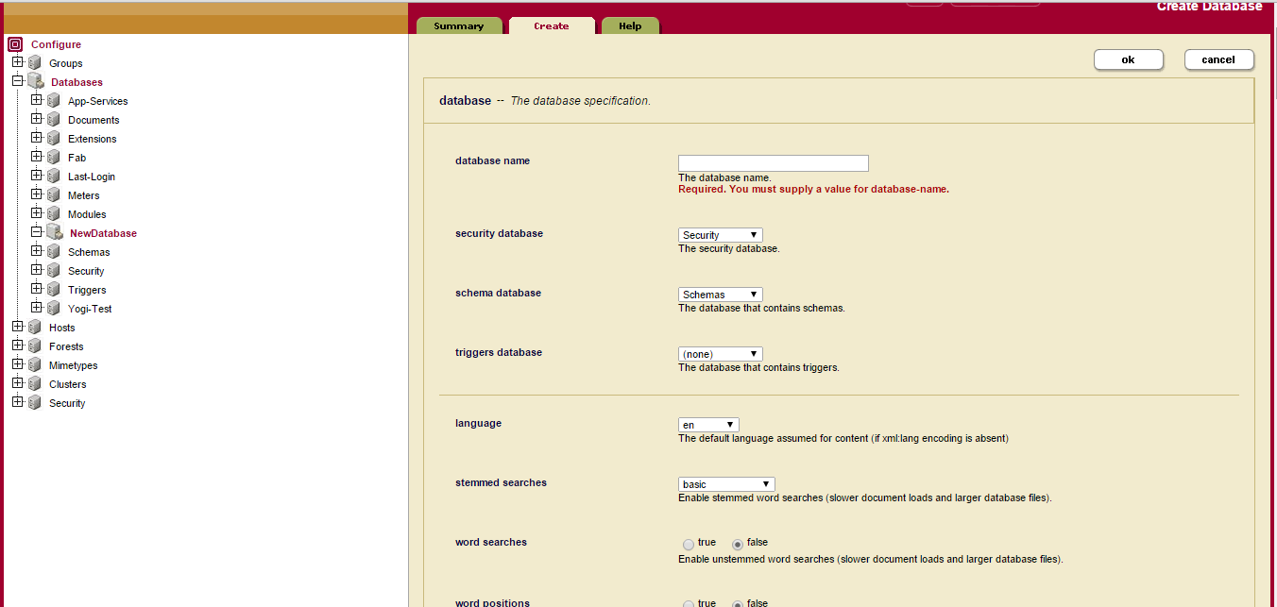
Creating DB Page

Slide 15
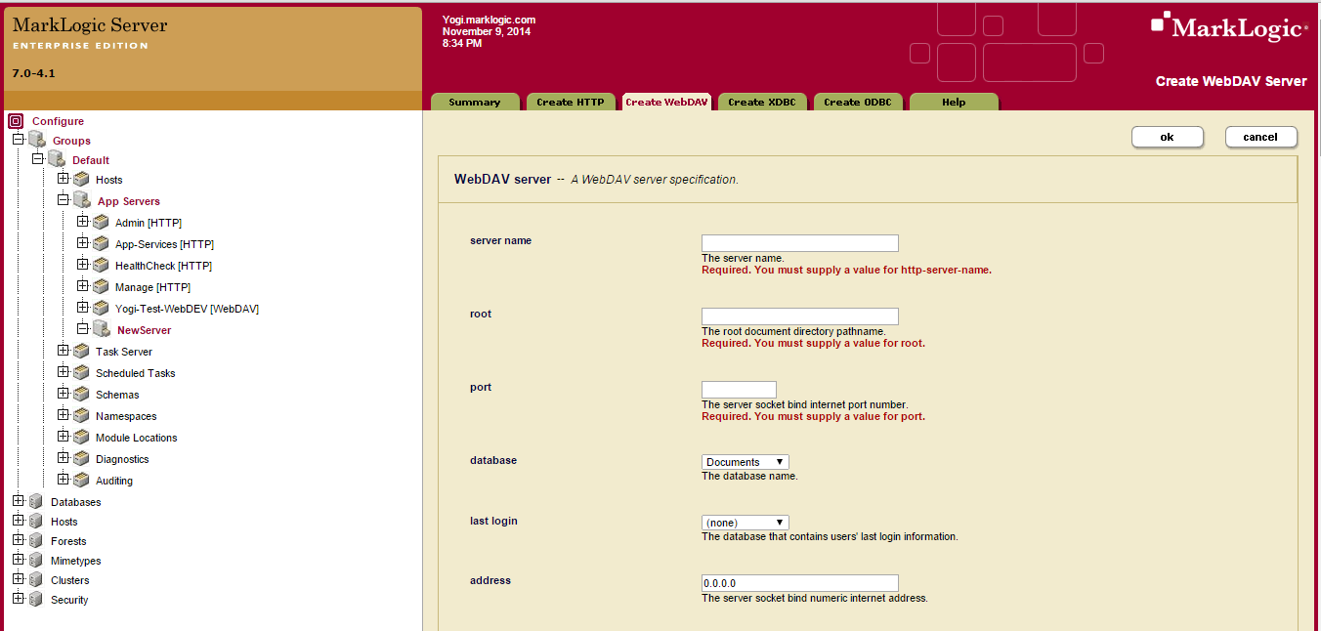
AppServer Page

Slide 16
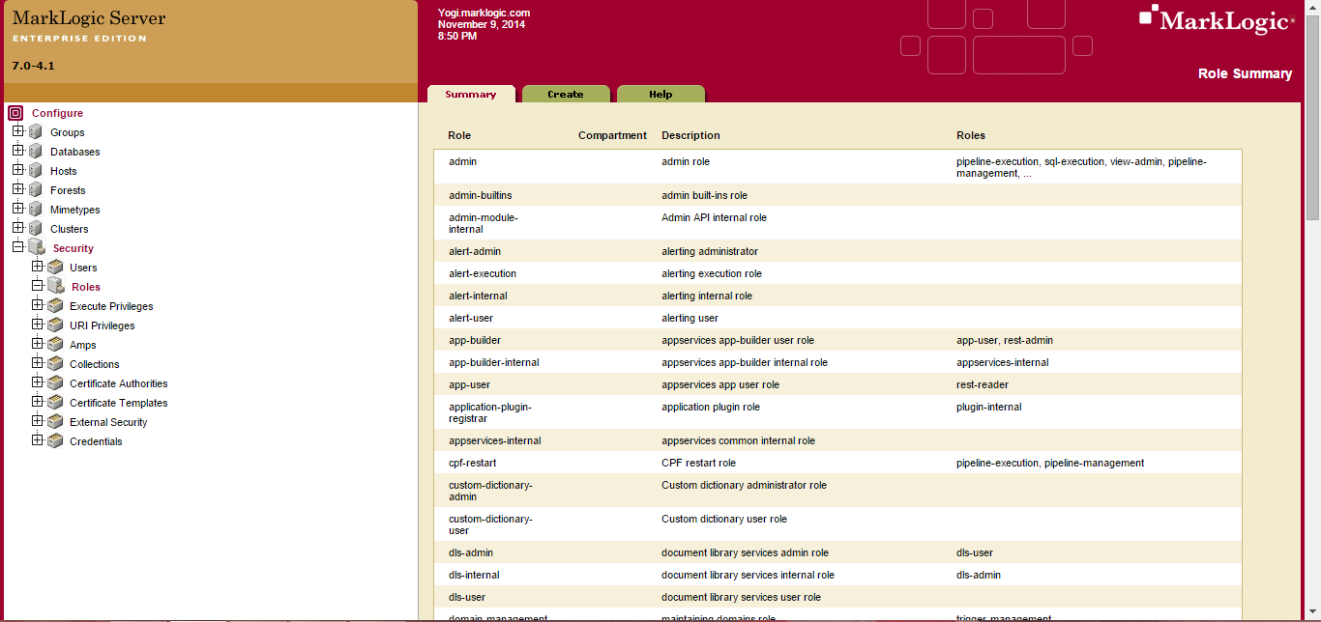
Security Page

Slide 17
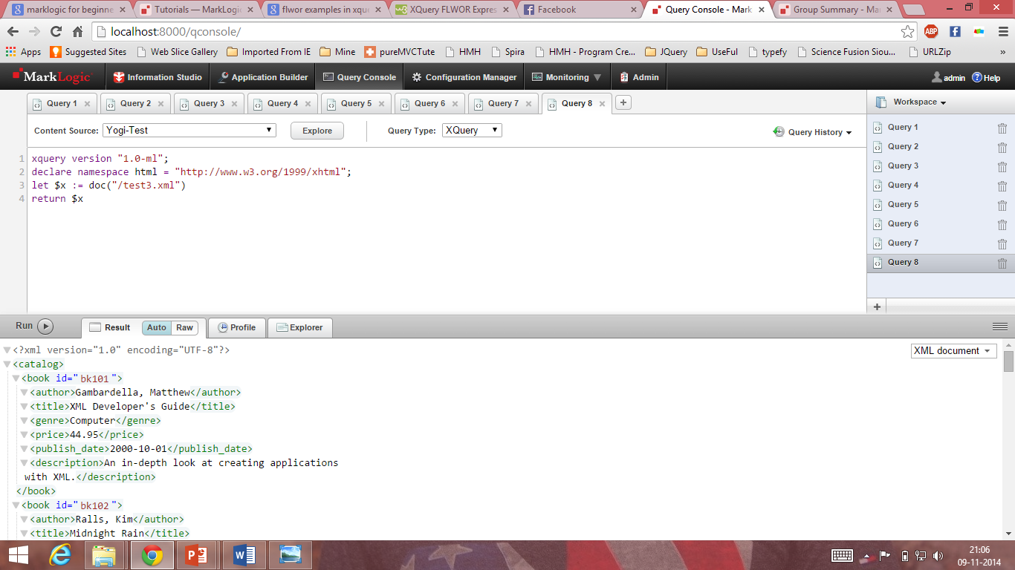
Reading XML Document

Slide 18
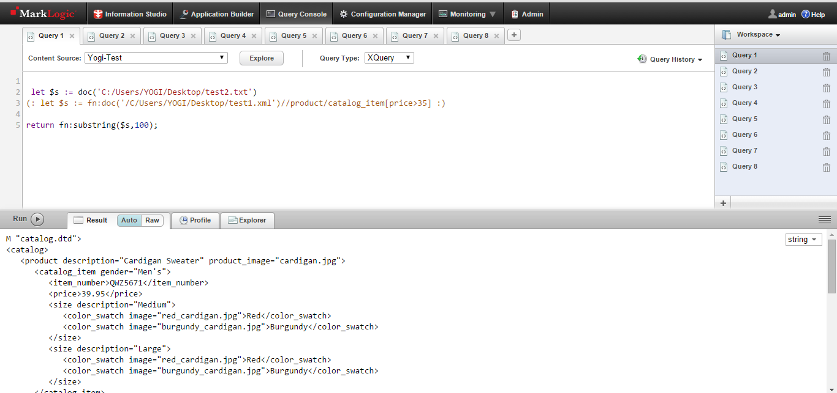
Reading Text Document

Slide 19
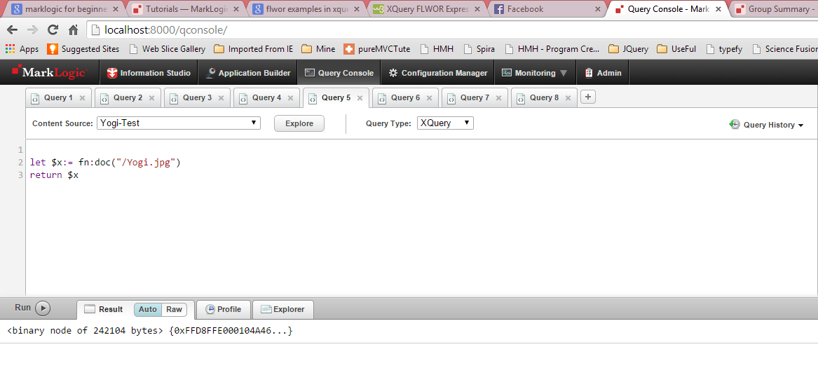
Reading Image Document

Slide 20
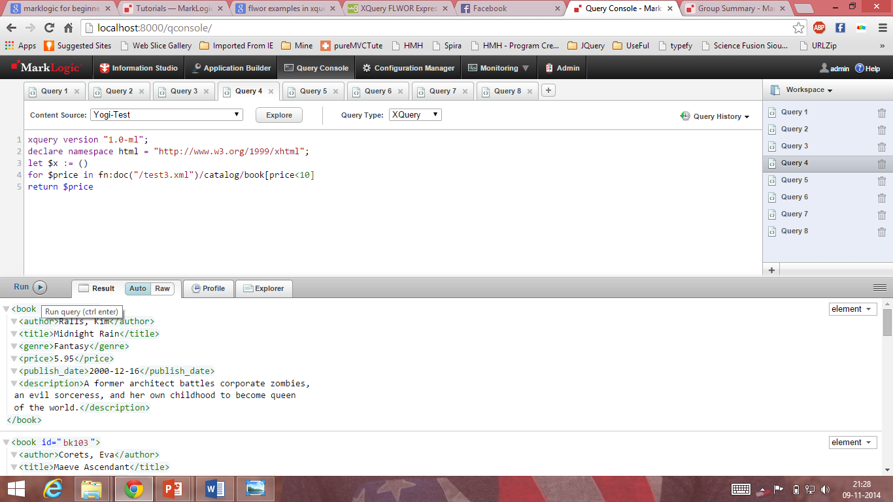
Filtering Using XPath Expression

Slide 21
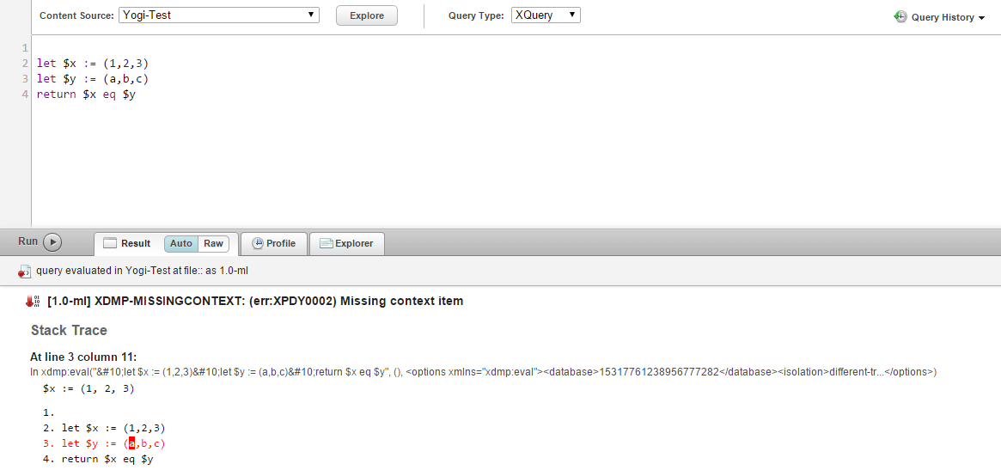
Comparing two different sequences

Slide 22
Q&A

Slide 23
Thank you

